Slide 1
Big data analytics in the Medical domain
Huiran Liu
Roxana Tapia
Oliver Budke

Slide 2
Agenda
Project objectives
Medical background
Glossary of Terms
Blood Pressure Chart for Adults
Influences on ABP
Preliminary Plan of Implementation
Clarification
Data Preprocessing
Feature Extraction
Training & Testing the Prediction Model
Model Evaluation
Next steps
Discussion / Questions
Notes:
Project Objectives and Medical Background: Oliver
Next Steps: Roxana
Discussion / Questions: Oliver

Slide 3
Project objectives
Predict Acute Hypotensive Episode (AHE) in one hour forecast window
Estimate significant parameter for the same forecast window
Real-time analysis of data stream
Visualisation of incoming data
Objectives are NOT
Predict data after the one hour forecast window
Include other parameters than those included in the PhysioNet academic challenges

Slide 4
Glossary of Terms
Terms | Unit of measurement | Meaning
Time and date | hh:mm:ss dd/mm/yyyy
HR | bpm | Heart Rate (as felt through the walls of a peripheral artery)
ABPSys | mmHg | Systolic Pressure of Arterial Blood
ABPDias | mmHg | Diastolic Pressure of Arterial Blood
ABPMean | mmHg | Mean of Arterial Blood Pressure
Pulse Pressure | mmHg | typically ranges between 40 and 50 mmHg
RESP | pm
SpO2 | - | Saturation of Peripheral Oxygen
NBPSys | mmHg | Systolic Pressure of non-invasive Blood
NBPDias | mmHg | Diastolic Pressure of non-invasive Blood
NBPMean | mmHg | Mean of Non-invasive Blood Pressure
Notes:
A millimeter of mercury is a manometric unit of pressure, formerly defined as the extra pressure generated by a column of mercury one millimetre high and now defined as precisely 133.322387415 pascals
systolic pressure (pressure when the heart contracts)
diastolic pressure (pressure when the heart rests)
Elevation in heart rate does not cause your blood pressure to elevate at the same proportion, why. It is because even though your heart beat raises; healthy blood vessels dilate (expands) to permit more blood to flow easily. It is possible for your heart rate to double with only a modest rise in blood pressure.

Slide 5
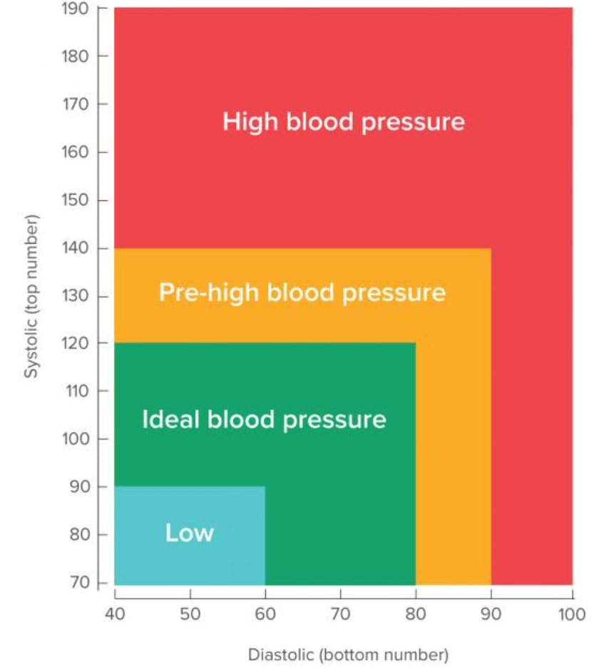
Blood Pressure Chart for Adults
Acute Hypotensive Episode
ABPSys < 90
ABPDias < 60
→ ABPMean = 70

Slide 6
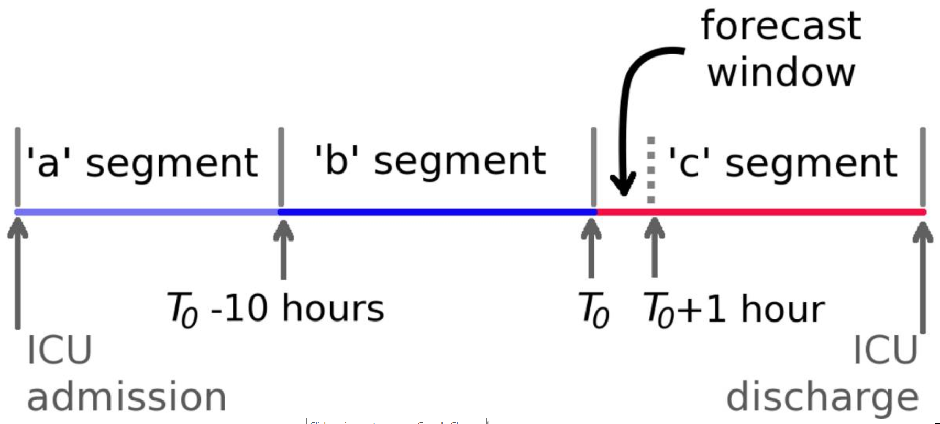
Influences on ABP
throughout the day blood pressure varies depending on
medications
nutrition
time of day
body position
breathing rhythm
stress level
physical condition
usually lowest at night and rises sharply on waking
Notes:
Throughout the day, blood pressure varies, depending on body position, breathing rhythm, stress level, physical condition, medications you take, what you eat and drink, and time of day. Blood pressure is usually lowest at night and rises sharply on waking.

Slide 7
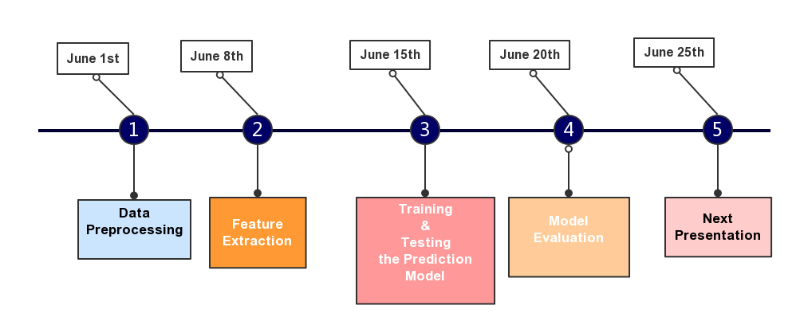
Preliminary Plan of Implementation

Slide 8
Clarification/Again
Acute Hypotensive Episode (AHE) is defined for the purposes of this challenge as any period of 30 minutes or more during which at least 90% of the MAP(ABPmean) measurements were at or below 60 mmHg.
Given Data
Target patient is adults
Forecast window: This is defined as the one-hour period immediately following a specified time T0
Wave Form Record
Numeric Record
Focus on the signal of MAP

Slide 9
Data Preprocessing
'Time and date' | 'HR' | 'ABPSys' | 'ABPDias' | 'ABPMean' | 'PULSE' | 'RESP' | 'SpO2' | 'NBPSys' | 'NBPDias' | 'NBPMean'
'hh:mm:ss dd/mm/yyyy' | 'bpm' | 'mmHg' | 'mmHg' | 'mmHg' | 'bpm' | 'pm' | '%' | 'mmHg' | 'mmHg' | 'mmHg'
'[22:01:00 29/06/2016]' | 0 | 0 | 0 | 0 | 0 | 0 | 0 | - | - | -
'[22:02:00 29/06/2016]' | 0 | 0 | 0 | 0 | 0 | 0 | 0 | - | - | -
'[22:03:00 29/06/2016]' | 0 | 0 | 0 | 0 | 0 | 28 | 0 | - | - | -
'[22:04:00 29/06/2016]' | 56.3 | 0 | 0 | 0 | 0 | 14.7 | 0 | - | - | -
'[22:05:00 29/06/2016]' | 51.6 | 0 | 0 | 0 | 0 | 12.6 | 0 | - | - | -
'[22:06:00 29/06/2016]' | 56 | 0 | 0 | 0 | 54.2 | 16.3 | 99.5 | - | - | -
'[22:07:00 29/06/2016]' | 56 | 0 | 0 | 0 | 67.3 | 16.7 | 100 | - | - | -
'[22:08:00 29/06/2016]' | 52.7 | 0 | 0 | 0 | 0 | 16.9 | 0 | 125 | 64 | 84
'[22:09:00 29/06/2016]' | 53.5 | 0 | 0 | 0 | 53.2 | 17.7 | 98.5 | - | - | -
'[22:10:00 29/06/2016]' | 53.1 | 0 | 0 | 0 | 53.1 | 16.4 | 99 | - | - | -
'[22:11:00 29/06/2016]' | 52.8 | 0 | 0 | 0 | 52.4 | 17 | 97.9 | - | - | -
'[22:12:00 29/06/2016]' | 53.8 | 135.8 | 60.4 | 87 | 53.1 | 18.2 | 97 | - | - | -
'[22:13:00 29/06/2016]' | 53.2 | 138.8 | 66.8 | 91.6 | 53 | 17.9 | 98.1 | - | - | -
'[22:14:00 29/06/2016]' | 54.1 | 0 | 0 | 0 | 53.7 | 15 | 99.2 | - | - | -
'[22:15:00 29/06/2016]' | 53.7 | 0 | 0 | 152.3 | 53.3 | 15.6 | 99.3 | - | - | -
'[22:16:00 29/06/2016]' | 51.7 | 139.7 | 67.7 | 92.3 | 53 | 15.8 | 99 | - | - | -
'[22:17:00 29/06/2016]' | 54.8 | 146.3 | 74.8 | 99 | 0 | 17.5 | 0 | - | - | -
'[22:18:00 29/06/2016]' | 58.1 | 141.5 | 71.9 | 95.9 | 0 | 17.9 | 0 | - | - | -

Slide 10
Data Preprocessing
Select 1 hour (or more) before T0
Format the date and time (no need to do this actually)
Filter the value of MAP
Higher than high arterial blood pressure (defined as >140 mmHg)
Lower than Lowest blood pressure(death or coma)
'[22:50:00 29/06/2016]' |  |  | 0
'[22:51:00 29/06/2016]' |  |  | 1
'[22:52:00 29/06/2016]' |  |  | 2
'[22:53:00 29/06/2016]' |  |  | 3
'[23:49:00 29/06/2016]' |  |  | 58
'[23:50:00 29/06/2016]' |  |  | 59

Slide 11
Preliminary Plan of Implementation

Slide 12
Feature Extraction
Linear Regression (not sure)
The wave form of MAP with 4 patients in different groups
Roxana Here ☺
Means of two clusters
Size of clusters with low value

Slide 13
Preliminary Plan of Implementation

Slide 14
Training & Testing the Prediction Model
Classification Problem
Input： The features we extracted in every patient
Labels: AHE in the forecast window occurred or not
(0,1)
Methods
SVM
Random Forest
……

Slide 15
Preliminary Plan of Implementation

Slide 16
Generalization & Model Evaluation
The goal of classification is generalization: prediction of new data
Estimate generalization performance
K-Folds Cross-validation
• Train model on part of data • Test model on other part of data • Repeat on different cross-validation folds • Average performance on test set across all folds

Slide 17
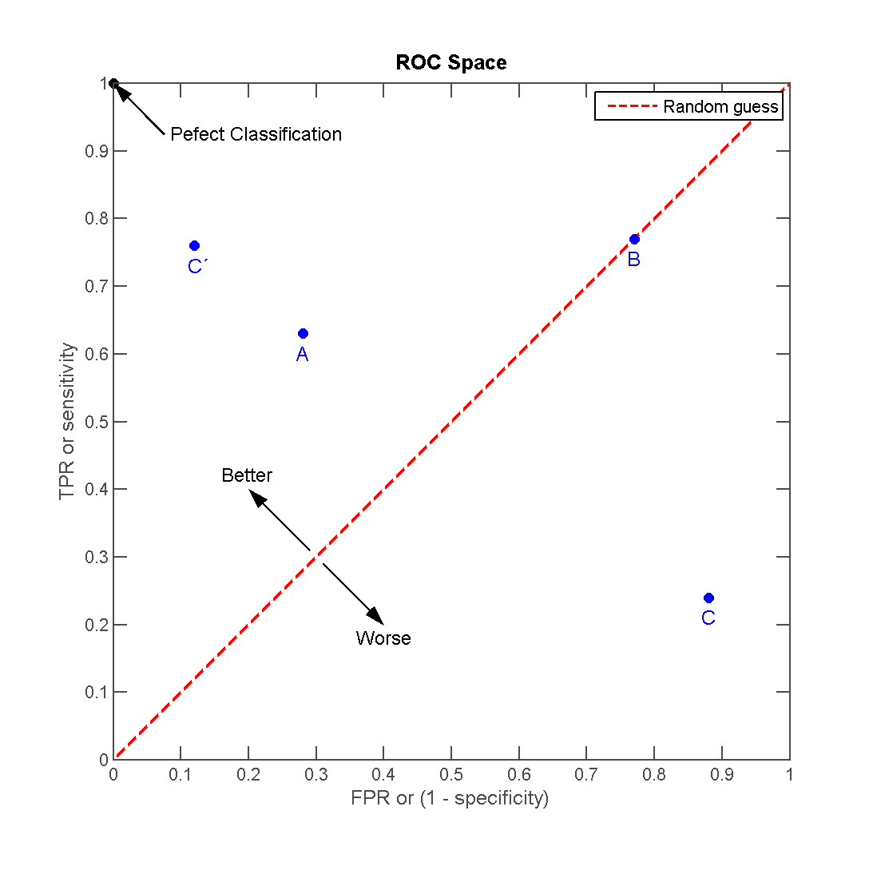
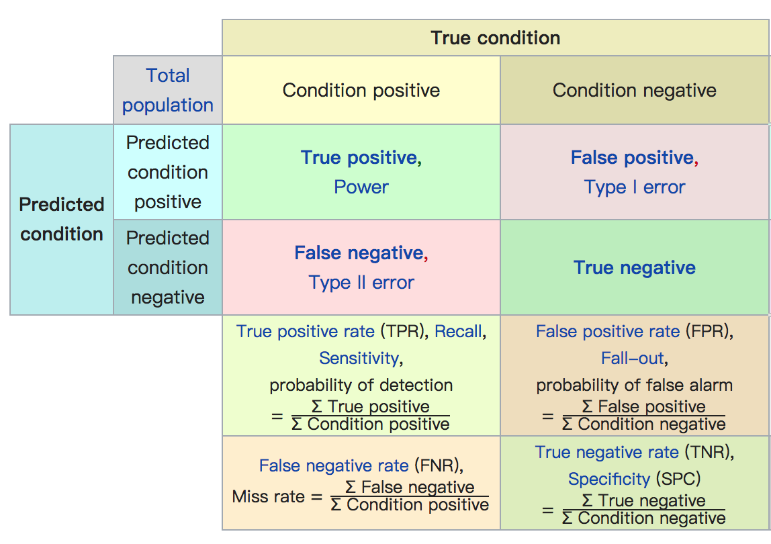
Generalization & Model Evaluation
AUC metric
Draw a ROC Curve and get the value of AUC(area under the receiver operator curve)
Confusion Matrix

Slide 18





Techniques

Slide 19
References
https://en.wikipedia.org/wiki/Blood_pressure
https://en.wikipedia.org/wiki/Receiver_operating_characteristic
https://www.mayoclinic.org/diseases-conditions/low-blood-pressure/symptoms-causes/syc-20355465
http://www.cvphysiology.com/Blood%20Pressure/BP006

